Slide 1
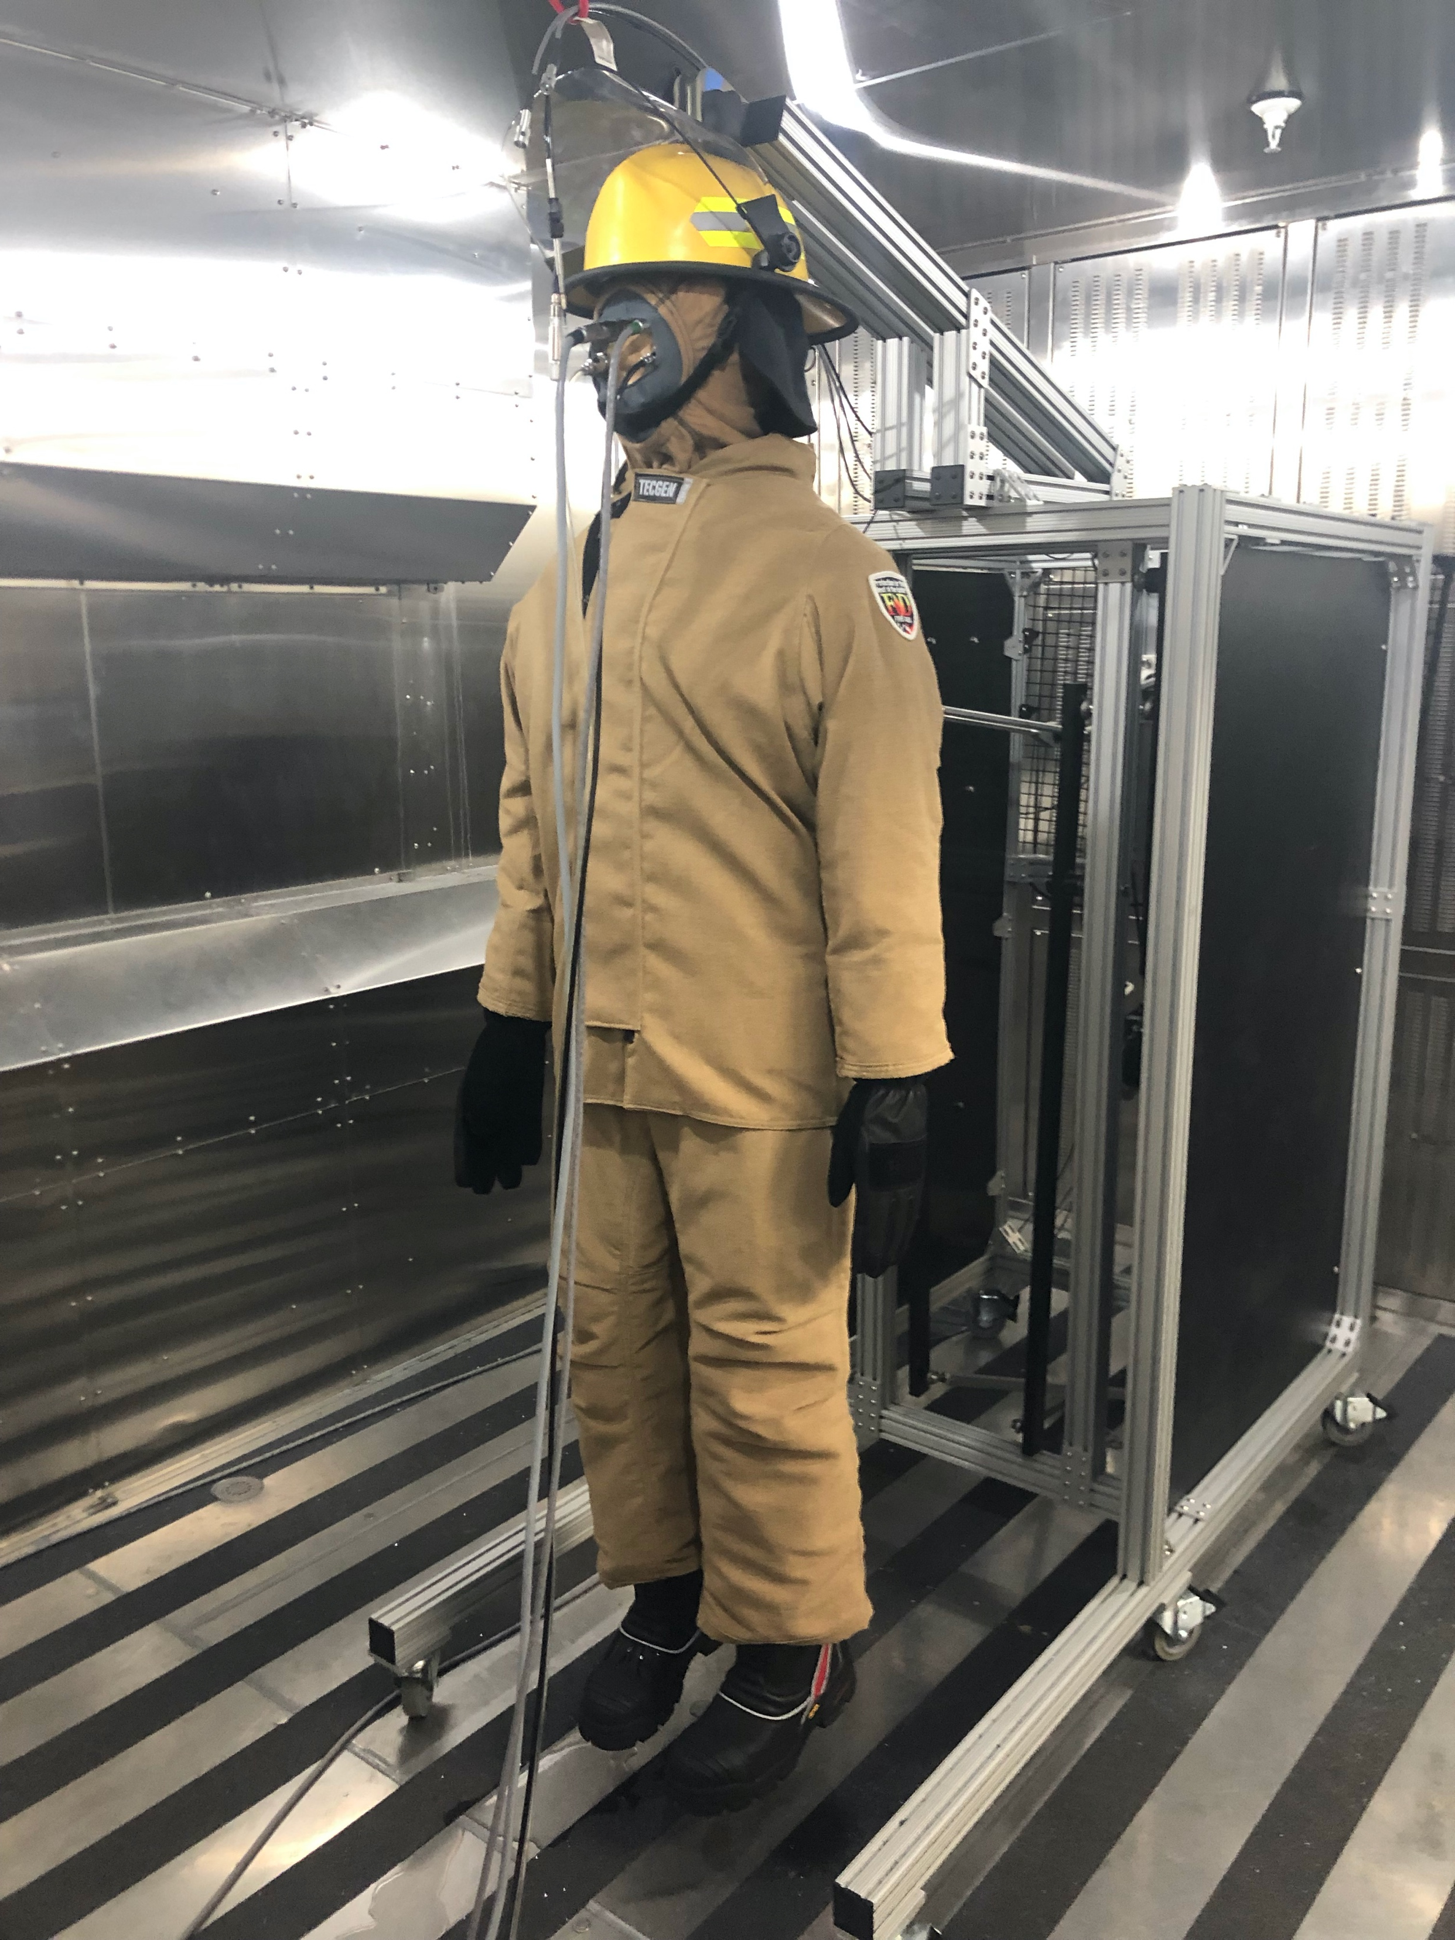
Thermal Manikin Comfort Assessment of Lightweight PPE for Structural Firefighters
Presented by: Ana Grande and Allison Barnes
Advisors: Dr. Meredith McQuerry and Maddy Bogan
Florida State University, Jim Moran College of Entrepreneurship
Introduction
Methods
Discussion
Heat exhaustion is a common problem that industrial workers face, especially in strenuous professions such as firefighting. According to the NFPA, “Overexertion, stress, and medical issues accounted for more than half of the deaths in 2020.” (Fahy & Petrillo, 2021). Clothing is a factor that influences overall thermal comfort which impacts the performance and health of these industrial workers. Dr. McQuerry completed a past study with human subjects in simulated conditions to tests the effects of suit material. This resulted in an insignificant difference in total heat loss between the lightweight and traditional weight control turnout suits. The current project, Thermal Manikin Comfort Assessment of Lightweight PPE for Structural Firefighters is a continuation of the 2018 experiment to determine significant differences in thermal insulation, evaporative resistance, and total heat loss (W/m²) exist between the two types of composite materials. Ongoing research will assess the suits in both static (standing) and dynamic (walking) conditions for thermal insulation (dry) and evaporative resistance (wet).
Equipment:
ThermaNOLE® Comfort Lab testing chamber
ESPEC Model No EWPL976-12NWL manufactured in Hudsonville, MI
Keeps a control environment ambient temperature, windspeed, and relative humidity
ANDI® Thermal Manikin
Manufactured by Thermetrics in Seattle, WA.
Measures condition of human body comfort in relation to ambient environment
Testing Materials
Light Weight material firefighter suit
Control composite firefighter suit
Testing variables
Wet or dry
Static (Standing) or Dynamic (walking)
Lightweight or control suit
What is being tested
Thermal insulation measured by convection, conduction, and radiation (dry)
Evaporation resistance in comparison to set sweat rates (wet)
total heat loss (THL) of a garment when worn on the human body. (both wet & dry combined)
Summary of results
The comparison of the lightweight material versus the control suit in regard to heat flux generated is ongoing
Limitations:
ANDI often experiences technical difficulties and often must be sent back to headquarters in Seattle or have a mechanic come to Tallahassee to help fix multiple issues
At one point in the experiment ANDI’s hand snapped which set back our ability to conduct testing
We work to fix minor issues such as broken sweat glands, electrical wiring issues, and replenish DI water for sweat
Future direction:
Ongoing project
Continues testing the different ambient conditions to make discoveries surrounding the effectivity of different PPE gear
Abstract
Heat exhaustion and heat-related illness is a common issue that firefighters experience due to the strenuous nature of their job. This study evaluates their personal protective clothing (PPC) to test overall thermal comfort with lighter weight materials to determine how PPC can be better designed to fit the needs of firefighters. A structural firefighter turnout suitwith a novel lightweight material was tested in the ThermaNOLE Comfort Lab®. This lab is equipped with ANDI, a state-of-the-art dynamic sweating thermal manikin that offers heightened sensitivity to measure heat loss and gain, allowing researchers to simulate human physiology while testing garments. A series of tests were conducted with the thermal manikin to evaluate both the new lightweight suit and a traditional weight control suit. Findings will determine whether the lightweight materials will improve the heat loss and thermoregulation capabilities of firefighters.
References/Acknowledgements
Results
We would like to thank Dr. Meredith McQuerry and Maddy Bogan for giving us the opportunity to work in this research project and begin out journeys in research.
Fahy, R., & Petrillo, J. (2021). Firefighter fatalities in the US in 2020 - NFPA. Firefighter Fatalities in the US in 2020. Retrieved February 28, 2022, from https://www.nfpa.org/-/media/Files/News-and-Research/Fire-statistics-and-reports/Emergency-responders/osFFF.pdf
M. McQuerry, M. Morrissey, J. Kisiolek, S. Gipson, and M. Ormsbee, “Effect of a Lightweight
Structural Firefighter Turnout Composite on Physiological Comfort,” in Performance of
Protective Clothing and Equipment: 11th Volume, Innovative Solutions to Evolving Challenges,
ed. K. Lehtonen, B. P. Shiels, and R. B. Ormond (West Conshohocken, PA: ASTM International,
2020), 176–203. http://doi.org/10.1520/STP1624201900836
Although this research is still ongoing, we have completed the dry testing which can be summarized below

